Slide 1
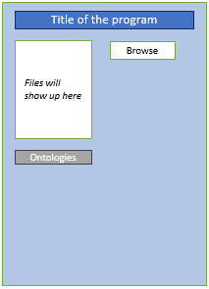
Core Functionality
Basic Functionality
Ontology Functionality
Detailed Purpose: TBD
Purpose: write the Ontology to corresponding place in the file
Input: 4 types of bioinformatic file
Output: modified file and their backups
Purpose: collect users input of Ontology
The functions in BLUE BOX have Version0
Github (RunyuWU branch):
https://github.com/EvanWu19/ExternalOntologyforCERF
Purpose: log the Ontology modification to ontology_changes.csv for CERF to use
Output: update ontology_changes.csv

Slide 2
Ontology Functionality
Basic Functionality
Ontology Functionality
Detailed Purpose: TBD
Purpose: write the Ontology to corresponding place in the file
Input: 4 types of bioinformatic file
Output: modified file and their backups
Purpose: collect users input of Ontology
The functions in BLUE BOX have Version0
Github (RunyuWU branch):
https://github.com/EvanWu19/ExternalOntologyforCERF
Purpose: log the Ontology modification to ontology_changes.csv for CERF to use
Output: update ontology_changes.csv

